Slide 1
Patient Survival Prediction
DATS 6101
SURYA VAMSI PATIBALLA

Slide 2
Abstract
I initiated Part - 1 to analyze the "Patient Survival Prediction" dataset, containing around 92,000 entries with 190 variables, to predict patient survival in healthcare. My preprocessing involved handling missing values, outliers, and analyzing data relationships. The dataset, including metrics like heart rate and creatinine levels, aims to determine survival outcomes. I am using classification models like logistic regression, as my target variable, 'hospital_death', is binary. This real-world application can enhance medical diagnosis accuracy, saving lives and time. Additionally, it could reveal the impact of intensive care units on patient health.

Slide 3
DATA COLLECTION
DATA PREPROCESSING
EXPLORATORY DATA ANALYSIS
CORRELATION & COLLINEARITY ANALYSIS
FEATURE SELECTION
SPLITTING DATA INTO TRAINING AND TESTING
APPROPRIATE MODEL BUILDING
HYPER PARAMTER TUNING
CALCULATING ACCURACY & OTHER METRICS
STEPS AFTER EDA

Slide 4
HANDLING MISSING VALUES
MEDIAN
MODE
CLUSTER SPECIFIC IMPUTATION
HOT-DECK IMPUTATION
LOGICAL REGRESSION IMPUUTATION
MEAN

Slide 5
FEATURE SELECTION
Chi – Squared Test
LASSO Regression
Correlation with Target Variable
Stepwise Regression

Slide 6
Chi-Squared Test
Evaluate Results:
Chi-squared Statistic: Measures the discrepancy between observed and expected frequencies. A higher value indicates a greater discrepancy.
P-value: Determines the significance of the results. A low p-value (typically < 0.05) suggests that the observed association is unlikely to be due to chance, indicating a significant relationship.
Degrees of Freedom: Calculated based on the number of categories in the variables. It's important for interpreting the chi-squared statistic.
Limitations and Assumptions: The Chi-squared test assumes that the data are independent, and each category combination has a sufficient count, typically at least 5. It's not suitable for continuous variables or where expected frequencies are too low.

Slide 7
LASSO Regression
LASSO Regression:
Purpose: Ideal for variable selection and regularization, especially beneficial in datasets with a large number of features where only a few are expected to be significant.
Method: Shrinks coefficients of less important features to zero, simplifying the model and highlighting key predictors.
Application: In your dataset, LASSO can be instrumental in identifying crucial predictors for 'hospital_death' from a wide array of variables like 'age', 'bmi', 'bilirubin_apache', etc.

Slide 8
Correlation with Target Variable
Fit a regression model in R with 'hospital_death' as the dependent variable and all other variables as independent.
Calculate VIF for each independent variable using an R package to identify multicollinearity.
High VIF values (>5 or >10) indicate strong multicollinearity.
Address high VIFs by removing, combining variables, or applying PCA.
Iterate the process to balance statistical validity and clinical relevance.
Interpret model changes within the healthcare context with expert consultation.

Slide 9
Stepwise Regression
Prepare Your Data:
Ensure that your dataset is loaded into R, typically as a data frame.
Remove non-predictive variables such as 'patient_id' and 'hospital_id'.
Select the Initial Model:
For forward selection, start with the simplest model: lm(hospital_death ~ 1, data=your_data).
For backward elimination, start with the full model: lm(hospital_death ~ ., data=your_data).
Perform Stepwise Regression:
Use stepAIC function from the MASS package, which selects the best model based on AIC.
For forward selection: stepAIC(initial_model, direction="forward", scope=list(lower=initial_model, upper=full_model)).
For backward elimination: stepAIC(initial_model, direction="backward").
For both directions: stepAIC(initial_model, direction="both").

Slide 10
Why can’t we perform feature Scaling
Vital Signs: Blood pressure readings, such as systolic and diastolic values, are often correlated. Similarly, heart rate and pulse rate can show multicollinearity.
Lab Test Results: Various blood test results, like cholesterol levels (HDL, LDL, and total cholesterol), can be highly correlated. Kidney function tests, like blood urea nitrogen (BUN) and creatinine, often move together.
Disease Comorbidities: Diseases like diabetes and hypertension or chronic kidney disease and cardiovascular disease tend to occur together, leading to multicollinearity in variables indicating these conditions.
Medication Usage: Patients on certain medications might be on other related medications as well. For instance, antihypertensive drugs, like ACE inhibitors and beta-blockers, might be prescribed together.
Treatment Procedures: If certain treatments are standard for a condition, the indicators for these treatments can be multicollinear. For example, in cancer treatment, chemotherapy and radiation therapy might be administered together.
Demographic Factors: Age can correlate with variables like the presence of certain age-related diseases, or the number of medications a patient is taking.
Patient History: A history of certain conditions can be predictive of others, such as a history of smoking being related to lung disease and cardiovascular issues.

Slide 11
MODEL BUILDING

Slide 12
MODEL BUILDING
LOGISTIC REGRESSION
DECISION TREE

Slide 13
Logistic Regression
Appropriate Model Choice: Logistic regression is suitable for binary outcomes, like 'hospital_death' in your dataset which is coded as 0 or 1.
Assumptions: Assumes linear relationship between the log-odds of the dependent variable and each independent variable. Assumes independence of observations and little to no multicollinearity among independent variables.
Variable Type: Can handle a variety of variable types (continuous, dichotomous, binary). Categorical variables like 'ethnicity', 'gender', and 'icu_type' should be encoded appropriately, often as dummy variables.
Feature Scaling: Not required for logistic regression, but can be beneficial for convergence and interpretation, especially when regularized models are used.
Interpretation of Coefficients: The coefficients represent the log-odds change associated with a one-unit change in the predictor variable, holding other variables constant.

Slide 14
Logistic Regression
Model Fit: Model fit can be assessed using measures like the pseudo-R-squared, likelihood ratio test, and Hosmer-Lemeshow test.
Regularization: To address potential overfitting and multicollinearity, L1 (LASSO) or L2 (Ridge) regularization can be applied.
Predictive Performance: The predictive performance of the model can be evaluated using metrics like accuracy, ROC curve, and area under the ROC curve (AUC).
Clinical Relevance: Coefficients and model predictions should be interpreted in the context of clinical significance and the underlying medical science.
Validation: It's crucial to validate the logistic regression model on a separate test set or through cross-validation to assess its generalizability to new data.

Slide 15
DECISION TREE
Model Structure: A Decision Tree is a flowchart-like structure where each internal node represents a feature, each branch a decision rule, and each leaf node a potential outcome.
Suitability for Categorical and Continuous Data: Handles both types effectively, making it appropriate for the diverse features in your dataset.
Interpretability: One of the most interpretable models, allowing clear visualization of how decisions are made, which is crucial in healthcare settings.
Handling Missing Values: Requires pre-processing to handle missing values, as it doesn’t inherently deal with them.

Slide 16
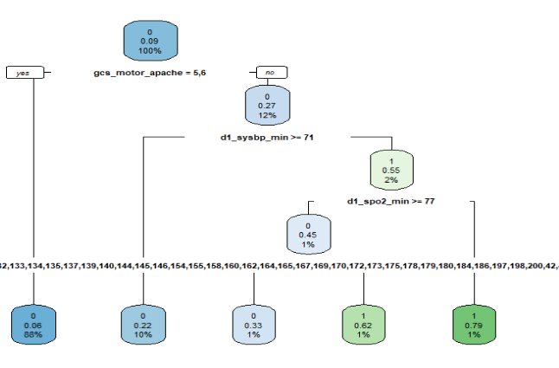

Slide 17
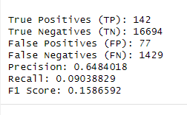

Slide 18
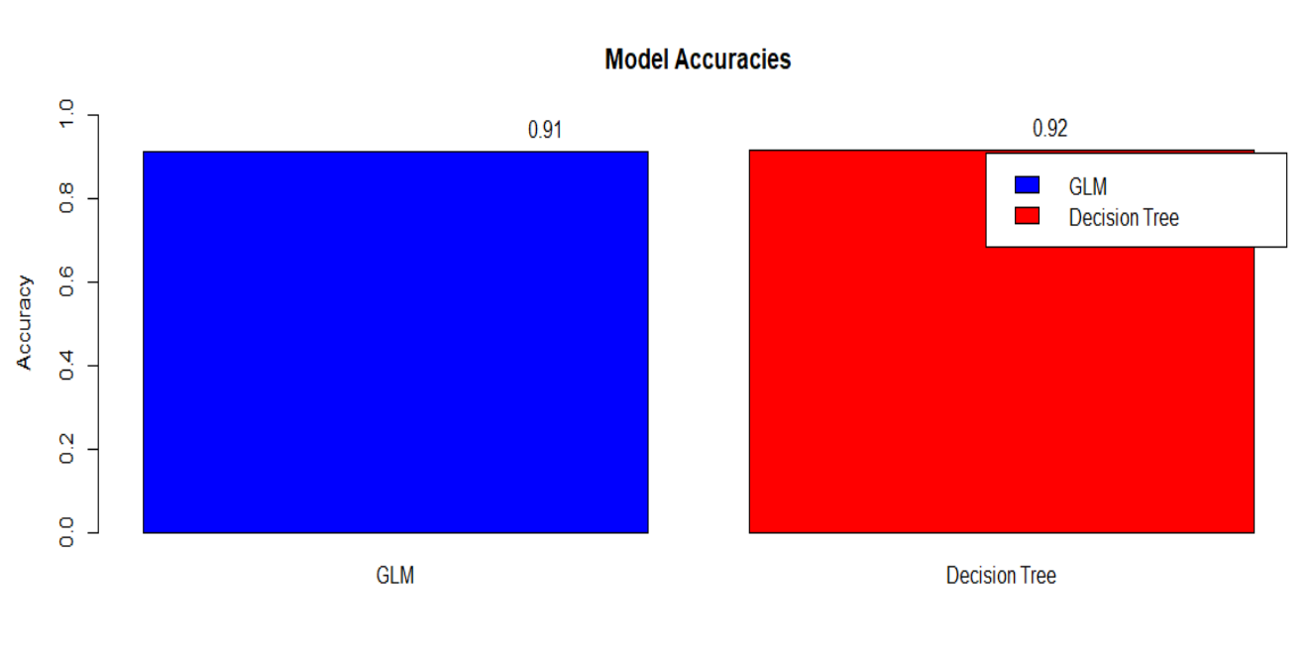

Slide 19
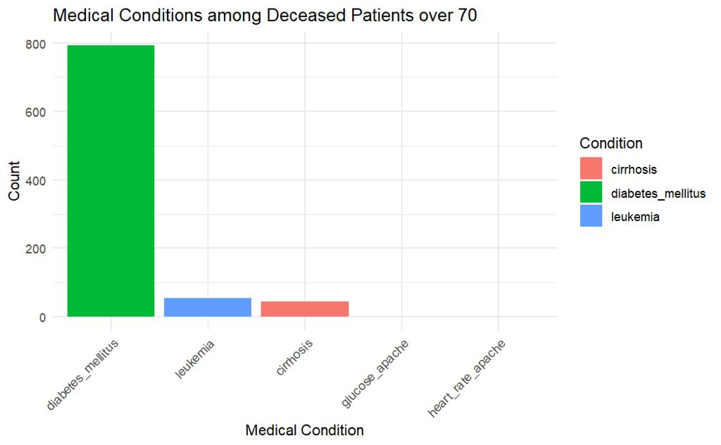
Which underlying medical disorders account for the majority of hospital deaths among patients over the age of 70? Are there any trends in the kinds of illnesses that cause death in this particular age range?

Slide 20
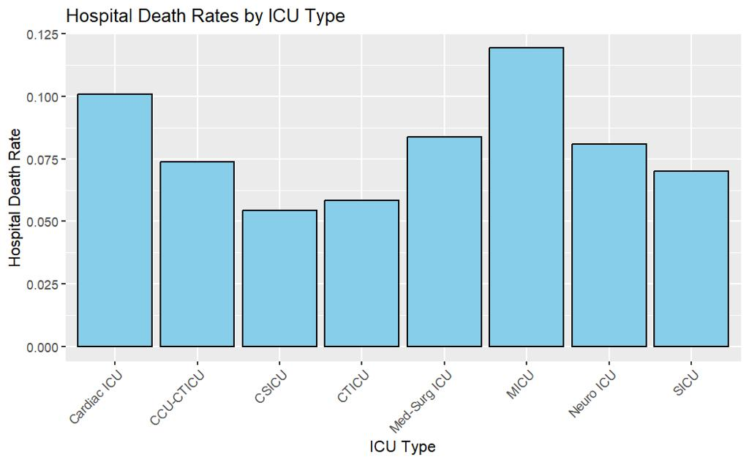
Which ICU types are most prevalent in the dataset, and does the type of ICU affect the risk of hospital death?

Slide 21
END

